Slide 1
Chapter 3
Measure of central tendency or Averages

Slide 2
Central Tendency
A central tendency is a single value which is used to represent an entire set of data. It is a value around which most of the values cluster. In other words , the tendency of the observation to concentrate around a central point is known as central tendency.
Measures of central tendency
To indicate the position or location of a central value to describe the central tendency of the entire data are called the measures of central tendency. In statistics there are various types of measures of central tendency, some of them are as follows:

Slide 3
Mathematical Averages
The most common types of average are
Arithmetic mean
Geometric mean
Harmonic mean
2. Positional Averages
Median
Mode
Quartiles
Deciles
Percentiles

Slide 4
Criteria of a satisfactory Average
Based on all the observations .
Simple to understand and easy to calculate.
Should be suitable for further mathematical treatment.
Should be affected as little as possible by the fluctuations of sampling.
There are various measures of central tendency of data. The most common and widely used measure is the arithmetic mean.
Arithmetic Mean
The arithmetic mean or simply the mean is the most familiar average. It is defined as a value obtained by dividing the sum of all the observations by the number of observations.
AM=Sum of all the observations/number of observations

Slide 5

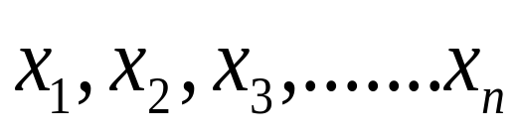
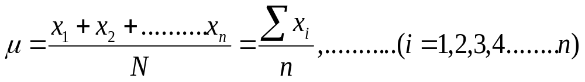
The mean may correspond to either a population or a sample from the population. If the given set of observations represents a population, the mean is called the population mean which is traditionally denoted by
Thus the population mean of a set of n observations
Is given by

Slide 6



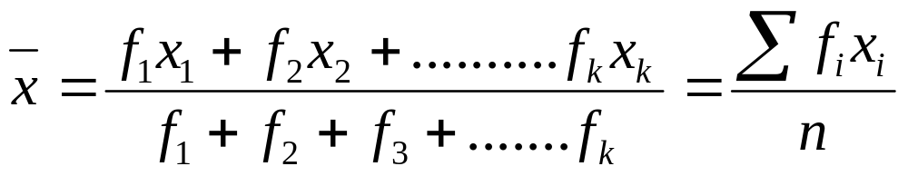
Where the Greek capital sigma is a convenient symbol for summation.
Mean from Grouped Data
When the number of observations is very large the data are organized into a frequency distribution, which is used to calculate the approximate values of descriptive measures as the identity of the observations is lost. To calculate the approximate value of the mean the observation in each class are assumed to be identical with the class mid point so that the product of the mid point by the
number of observations i.e. frequency would be equal to the sum of observations for each class.
Thus if the frequency distribution has k classes with mid points
And the corresponding frequencies
The given formula is used to calculate the mean

Slide 7


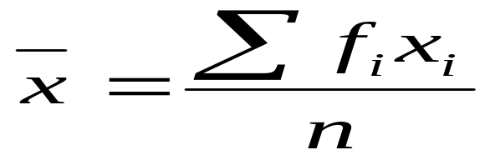
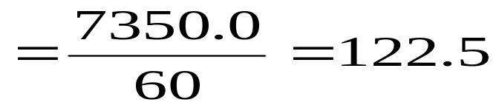
Example
Calculate the mean weight of apples from the data given below
weight |  | Mid points
65-84 | 9 | 74.5 | 670.5
85-104 | 10 | 94.5 | 945.0
105-124 | 17 | 114.5 | 1946.5
125-144 | 10 | 134.5 | 1345
145-164 | 5 | 154.5 | 772
165-184 | 4 | 174.5 | 698
185-204 | 5 | 194.5 | 972.5
Total | 60 |  | 7350
grams

Slide 8
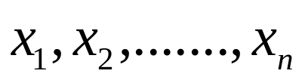

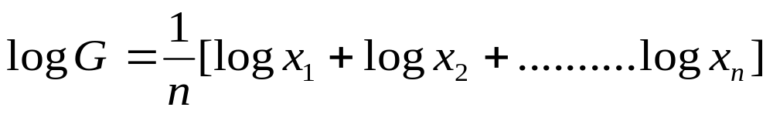
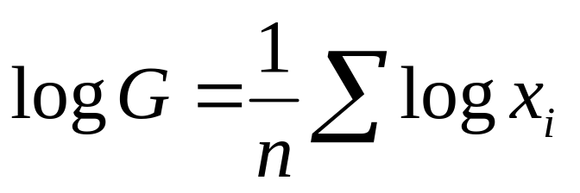
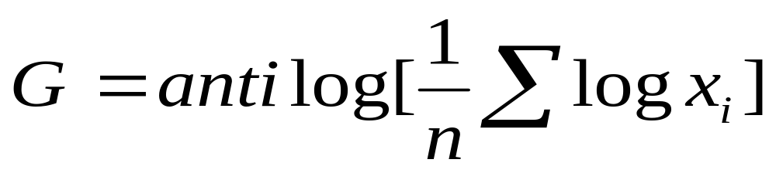
The Geometric mean
The geometric mean, G of a set of n positive values
is defined as the positive nth root of their product, i.e.
When n is large the computational of the geometric mean becomes laborious as we have to multiply all the values and then extract the nth root. The arithmetic is simplified by using logarithms to the base 10. Thus taking logarithms we get

Slide 9
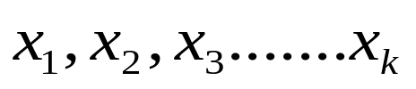
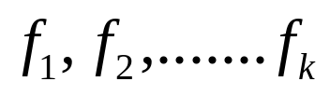
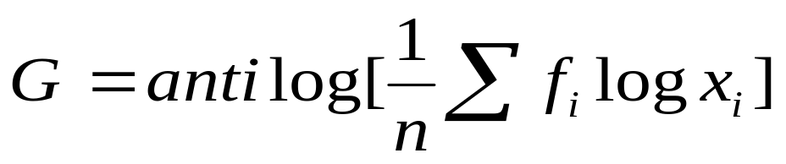
For Grouped data
For data organized into a frequency distribution having k classes with class marks
and the corresponding frequencies
the formula for the geometric mean is given by
Example
Find the geometric mean of 45, 32,37,46,39,36,41,48 and 36.
The geometric mean G is calculated as
Taking log we have

Slide 10
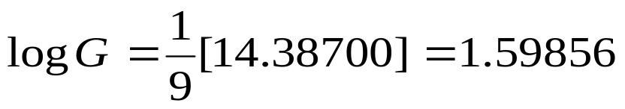

Example
Given the following frequency distribution of weights, calculate the geometric mean.
Weight | 65-84 | 85-104 | 105-124 | 125-144 | 145-164 | 165-184 | 185-204
f | 9 | 10 | 17 | 10 | 5 | 4 | 5
Solution
The computation of the geometric mean is shown below

Slide 11





Weight
65-84 | 74.5 | 9 | 1.8722 | 16.8498
85-104 | 94.5 | 10 | 1.9754 | 19.7540
105-124 | 114.5 | 17 | 2.0589 | 35.0013
125-144 | 134.5 | 10 | 2.1287 | 21.2870
145-164 | 154.5 | 5 | 2.1889 | 10.9445
165-184 | 174.5 | 4 | 2.2418 | 8.9672
185-204 | 194.5 | 5 | 2.2889 | 11.4445
 |  | 60 |  | 124.2483

Slide 12
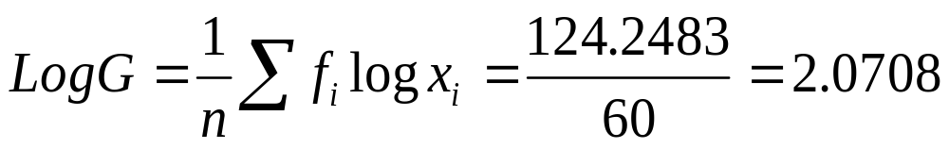

Importance of Geometric mean
We have already studies how the arithmetic mean can be used as a tool for obtaining averages. But what could be the use of geometric mean. Geometric mean is generally used in situations where small items are assigned large weights.
Geometric mean is useful for calculating the average percentage increase or decrease.
In index number geometric mean is considered as the best average.

Slide 13
Example
The price of a commodity increased by 8% from 1993 to 1994, 12 % from 1994 to 1995 and 76% 1995 to 1996. Find the average price increases from 1994 to 1996.
Solution:
Here the average of the percentage increase over a period of three years is to be computed so the most appropriate tool for calculating the average is geometric mean.
Year | Percentage increase | Price level at the end of the year with the preceding year as base | Log x
1993-1994 | 8 | 108 | 2.033423
1994-1995 | 12 | 112 | 2.049218
1995-1996 | 76 | 176 | 2.245512
 | Total |  | 6.328154

Slide 14
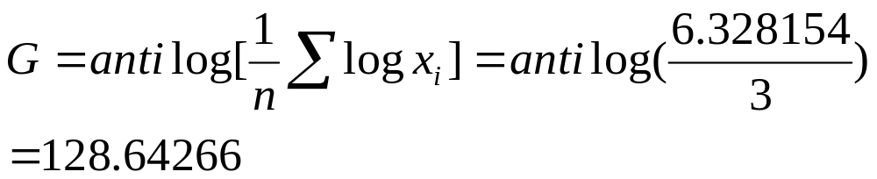
There fore the average increase from 1994-1996 is 128.64266-100=28.64266 %.

Slide 15
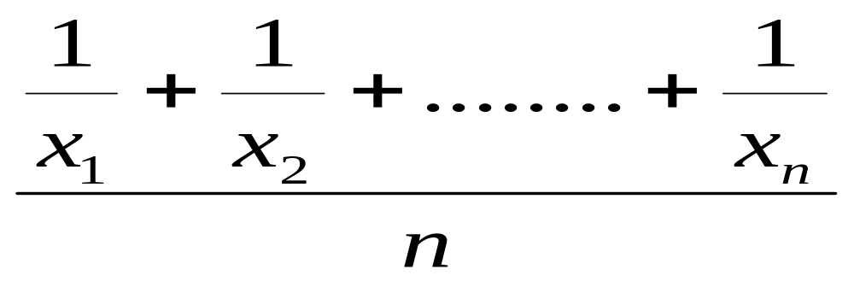
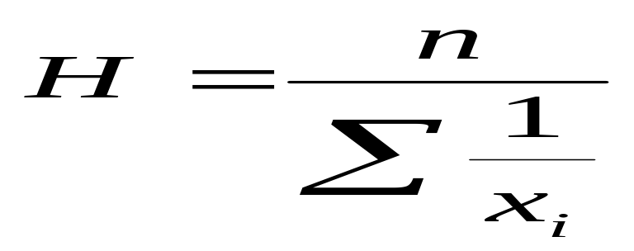
Harmonic mean for ungrouped data
The harmonic mean is the reciprocal of the arithmetic mean of the reciprocal of the variate, that is the harmonic mean is defined as
Harmonic mean=Reciprocal of

Slide 16

Harmonic mean for grouped data
For a grouped data means to say that we can represent data in the form of frequency distribution .

Slide 17
Example
Find the harmonic mean from the following frequency distribution of weights
Weight | 65-84 | 85-104 | 105-124 | 125-144 | 145-164 | 165-184 | 185-204
f | 9 | 10 | 17 | 10 | 5 | 4 | 5
We calculate the harmonic mean as below

Slide 18


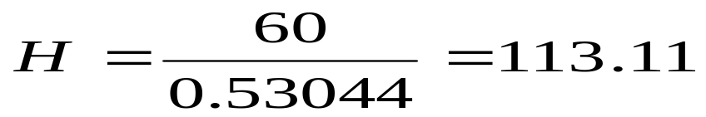
Weight (grams)
65-84 | 74.5 | 9 | 0.12081
85-104 | 94.5 | 10 | 0.10582
105-124 | 114.5 | 17 | 0.14847
125-144 | 134.5 | 10 | 0.07435
145-164 | 154.5 | 5 | 0.03236
165-184 | 174.5 | 4 | 0.02292
185-204 | 194.5 | 5 | 0.02571
 |  | 60 | 0.53044
Hence
Grams.

Slide 19
Relationship between AM, GM and HM
There exist a defined relationship between arithmetic mean , geometric mean
and harmonic mean.
When all the observation are same, the equality sign holds, that is
For any two observations,

Slide 20
The Median
The median is defined as a value which divides a data set that have been ordered ,
Into two equal parts , one part comprising of observations greater than and the other part smaller than it. Or more precisely the median is a value at or below which 50% of the ordered data lie.
Thus the sample median of the n observations x1,x2,x3,…….,xn when arranged in order from smallest to largest, is the middle value if n is odd , and the average of two middle values if n is even.
For grouped data into a frequency distribution the median is the value or a point on the horizontal scale through which a vertical line divides the histograms of the distribution into two equal parts of equal area. In other words the median is that value on the horizontal scale which corresponds to a cumulative frequency n/2. This value would lie in a certain group, called median group.

Slide 21

Where l is the lower limit of the median class , h is the width of the median class ,c represents the cumulative frequency corresponding to the group preceding the median class.

Slide 22
Example
Given below are the marks obtained by 9 students
45,32,37,46,39,36,41,48 and 36.
Find the median .
Solution:
To find the median and quartiles , we first arrange the marks the marks in order from lowest to highest. The ordered marks are
32,36,36,37, 39, 41,45,46,48
Here n=9 which is odd so 5 th value will be the median
Median =Marks obtained by ([n+1/2]) th student
=Marks obtained by 5 th student in ordered data
=39 marks
.

Slide 23
Example
Find the median, for the distribution of examination marks obtained given below
Marks | 30-39 | 40-49 | 50-59 | 60-69 | 70-79 | 80-89 | 90-99
Number of student | 8 | 87 | 190 | 304 | 211 | 85 | 20
To find the median marks ,quartiles etc by the process of linear interpolation, the data are assumed to be continuous. Thus we need the class boundaries as the cumulative frequencies correspond to upper class boundaries
Class boundaries | Mid points | Frequency | Cumulative frequency
29.5-39.5 | 34.5 | 8 | 8
39.5-49.5 | 44.5 | 87 | 95
49.5-59.5 | 54.5 | 190 | 285
59.5-69.5 | 64.5 | 304 | 589
69.5-79.5 | 74.5 | 211 | 800
79.5-89.5 | 84.5 | 85 | 885
89.5-99.5 | 94.5 | 20 | 905

Slide 24


Median= Marks obtained by (n/2)th student
=Marks obtained by 905/2, i.e. 452.5 th student which corresponds to marks in the class 59.5-69.5. Therefore

Slide 25


When the no of observations is quite large , the principle according to which a distribution or an ordered data set is divided into two equal parts may be extended to any no of divisions.
Quartiles
The three values which divides the distribution into four equal parts are called the Quartiles. These values are denoted by Q1,Q2,Q3 respectively .Q1 is called the first or lower quartile and Q3 is called the upper quartile. In other words Q1, Q2 and Q3 represents 25, 50 and 75 percent of the data. For ungrouped data the generalized formula for computing Quartiles are
And for a grouped data the percentiles can be calculated as follows

Slide 26


Deciles for ungrouped data
Similarly the nine values which divides the distribution into ten equal parts are called deciles and is denoted by D1, D2,……D9.
For grouped data

Slide 27

Percentiles
while the ninety nine values which divides the data into hundred equal parts are called percentiles and is denoted by p1,p2,p3………..,p99.
For ungrouped data the generalized formula for computing percentiles is given by
And for a grouped data the percentiles can be calculated as follows
Where k=1,2…..99 and other symbolic notations are discussed earlier.
.

Slide 28
The second quartile or the fifth deciles or the fiftieth percentiles is obviously identical with the median.
In case of grouped data , quartiles , percentiles and deciles are calculated in the Same way as the median

Slide 29
Example
Given below are the marks obtained by 9 students
45,32,37,46,39,36,41,48 and 36.
Find the lower and upper quartiles.
Solution:
To find the quartiles , we first arrange the marks the marks in order from lowest to highest. The ordered marks are 32,36,36,37,39,41,45,46,48
Here n=9 therefore
Now Q1= Marks obtained by ([n+1/4]) th student
Marks obtained by 3rd student=36 marks
Similarly
Q3= Marks obtained by ([3n+1]/4) th student
Marks obtained by 7th student= 45 marks.

Slide 30
Mode
The French word mode meaning fashion has been adopted to convey the idea of most frequent . The mode is defined as a value which occurs most frequently in a set of data , that is it indicates the most common result. A set of data may have more than one mode or no mode at all when all the observations occurs the same number of times.
In an ungrouped frequency distribution with classes consisting of single values , the mode can be calculating by examining the distribution.
When the data re organized into a grouped frequency distribution the mode would lie in the class that carries the highest frequency. This class is called the modal class. For most practical purposes it is sufficient to take the mid point of the modal class as the mode but generally it is a poor approximation . It therefore becomes desirable to decide at what point of the modal class , the mode should be located .

Slide 31

Where l= lower class boundary of the modal class, fm is the frequency of the modal class ,h is the width of the modal class and f1,f2 is the frequency associated with the class preceding and following modal class .

Slide 32
A distribution having a single mode is called a uni modal distribution while a distribution with two or more modes is called a bimodal or multimodal . It should be noted that that when a frequency distribution has classes of equal widths the modal class is the class with maximum frequency.
Example
Calculate the mode for the distribution of examination marks .
Marks | 30-39 | 40-49 | 50-59 | 60-69 | 70-79 | 80-89 | 90-99
Number of student | 8 | 87 | 190 | 304 | 211 | 85 | 20
Solution
The class that carries the highest frequency is 59.5-69.5 which is thus the modal class

Slide 33
Class boundaries | Mid points | Frequency | Cumulative frequency
29.5-39.5 | 34.5 | 8 | 8
39.5-49.5 | 44.5 | 87 | 95
49.5-59.5 | 54.5 | 190 | 285
59.5-69.5 | 64.5 | 304 | 589
69.5-79.5 | 74.5 | 211 | 800
79.5-89.5 | 84.5 | 85 | 885
89.5-99.5 | 94.5 | 20 | 905
Also l=59.5, f1=190, f2=211, fm=304 and h=10
Mode=65 marks.

